Slide 1
Retail Sales & Customer Behavior Analysis
Data Analyst Associate (CDA) Internship Project
By Meet Patel.

Slide 2
Goal: To analyze a cleaned MySQL database of 99k+ transactions and visualize key drivers of revenue across 10 major shopping hubs.
Revenue is heavily driven by female consumers (approx. 60%) and the 18-30 age demographic.
Clothing is the core product category, generating significantly more revenue than any other segment.
Geographic concentration is high, with the Mall of Istanbul acting as the primary revenue hub.

Slide 3
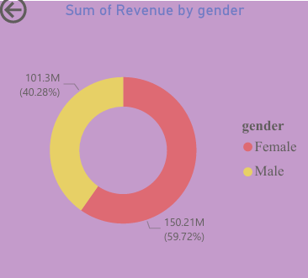
Gender Distribution & Revenue
Analysis:
Revenue Share: Females generated 150.21M (59.72%) of total revenue, while males contributed 101.3M (40.28%).
Volume: Based on total revenue, the female demographic represents the primary customer base for product volume and spending power.
Analyst Note: Source: Cleaned SQL Transactional Database (99k+ rows)

Slide 4
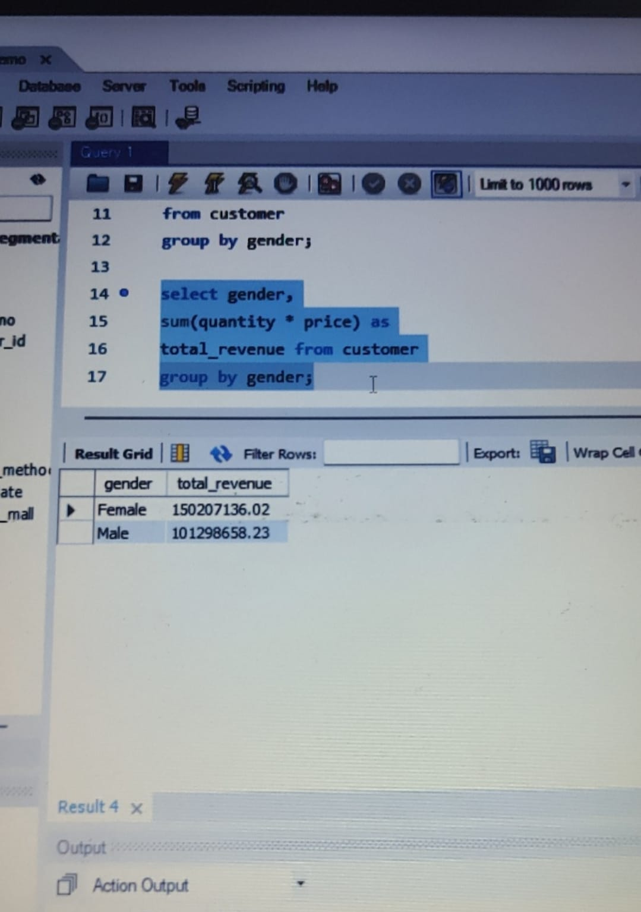
Most revenue earned by genders
The following queries represent the core logic used to solve Tasks 1–10.

Slide 5
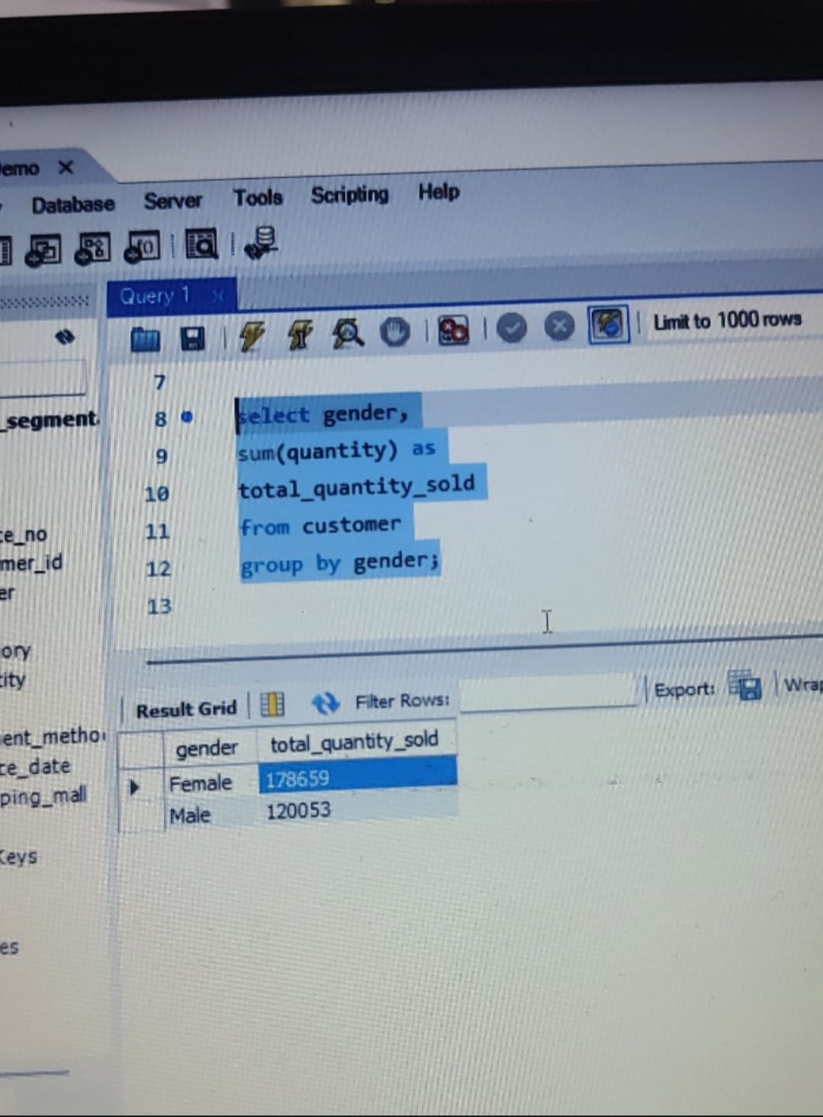
Most quantity sold to which gender.
The following queries represent the core logic used to solve Tasks 1–10.

Slide 6
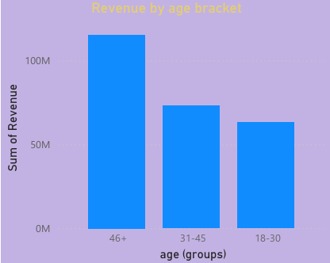
Age Group Performance
Analysis:
Top Performing Segment: The 18-30 age group is the most valuable, contributing 112.83M in revenue.
Mid-Tier: The 31-45 group follows with 88.08M.
Analyst Note: Source: Cleaned SQL Transactional Database (99k+ rows)

Slide 7
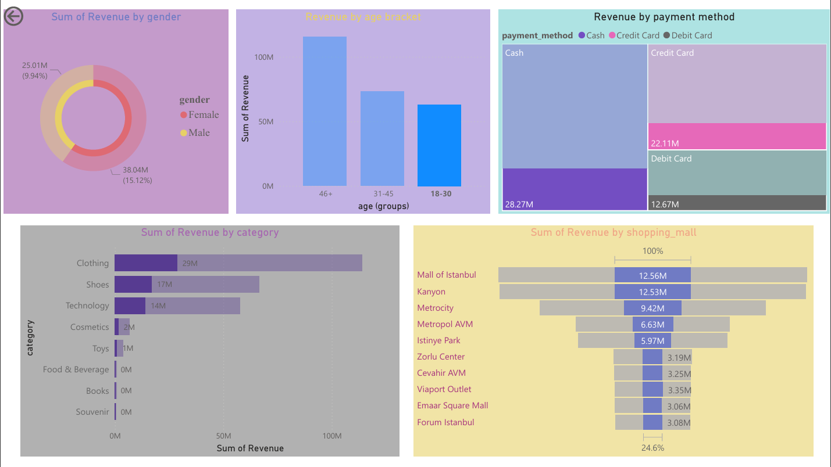
Age Group Performance - 2
Low-Tier: Revenue significantly drops in the 46+ demographic (50.60M), indicating a youth-centric market.
However, deep-dive analysis of high-value segments shows a pivot toward the 46+ demographic, where revenue peaks significantly higher than younger cohorts in specific transaction types.
Analyst Note: Source: Cleaned SQL Transactional Database (99k+ rows)

Slide 8
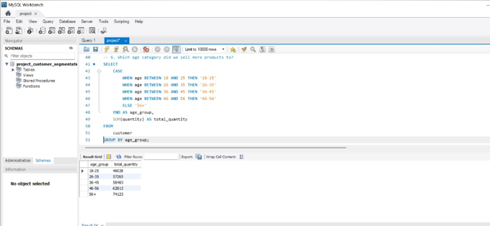
SQL Query sell most according to Age
The following queries represent the core logic used to solve Tasks 1–10.

Slide 9
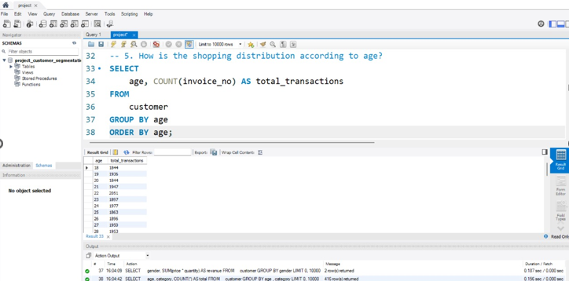
Most transactions by age group
The following queries represent the core logic used to solve Tasks 1–10.

Slide 10
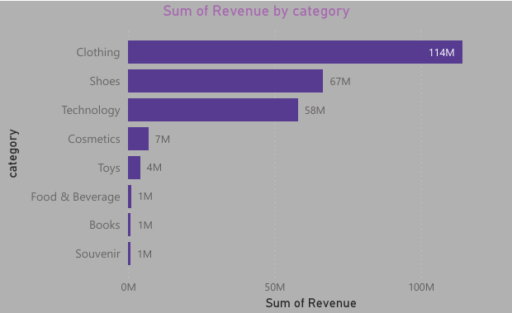
Product Category Deep-Dive
Top 3 Revenue Drivers:
Clothing: 114M
Shoes: 67M
Technology: 58M
Insight: Niche categories like Books, Souvenirs, and Food &
Beverage contribute minimally To the total revenue (approx. 1M each).
Analyst Note: Source: Cleaned SQL Transactional Database (99k+ rows)

Slide 11
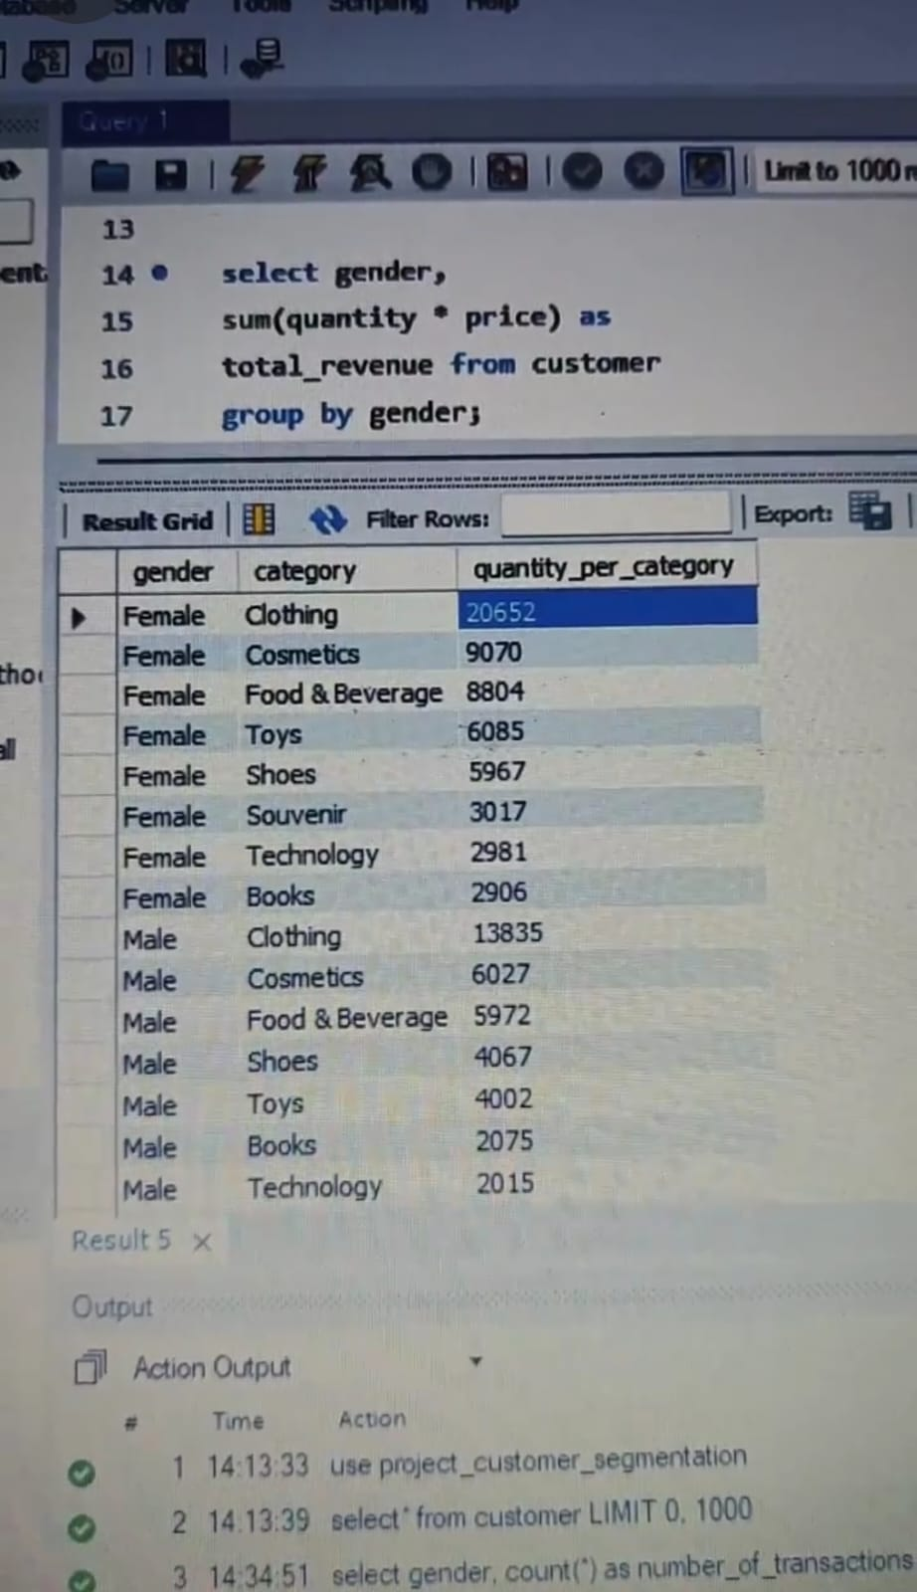
Distribution of purchase category
The following queries represent the core logic used to solve Tasks 1–10.

Slide 12
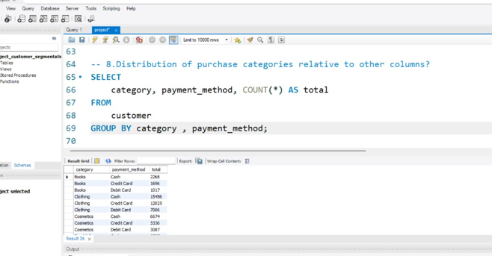
Relations to between purchase category and other columns
The following queries represent the core logic used to solve Tasks 1–10.

Slide 13
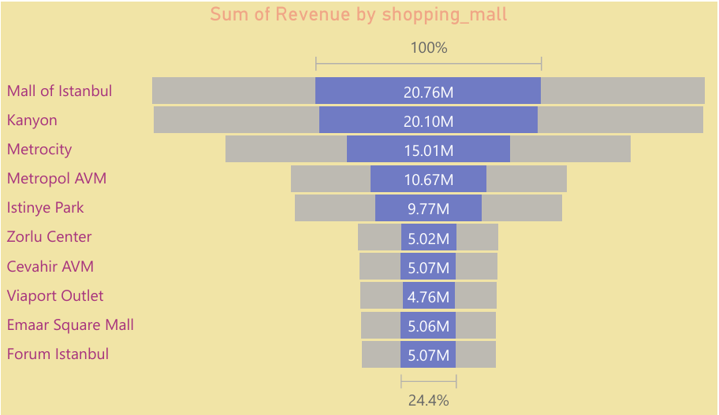
Geographic Performance (Shopping Malls)
Regional Insights:
The Mall of Istanbul is the leading location, accounting for 24.2% of total revenue.
Other high-performing hubs include Kanyon and Metro city.
Forum Istanbul represents the lowest regional revenue, suggesting a need for a localized strategy shift.
Analyst Note: Source: Cleaned SQL Transactional Database (99k+ rows)

Slide 14
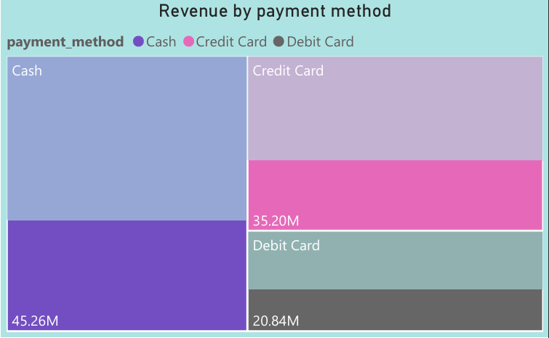
Payment Method Trends
Findings:
Customers primarily use Cash and Credit Cards for transactions.
Debit Card usage is the least common payment method.
Correlation: Higher-value categories (Technology/Shoes) tend to align with Credit Card usage,
while everyday purchases often utilize Cash.
Analysis:
There is a strong correlation between older shoppers (46+) and Cash payments (28.27M), while younger demographics trend toward digital methods
Analyst Note: Source: Cleaned SQL Transactional Database (99k+ rows)

Slide 15
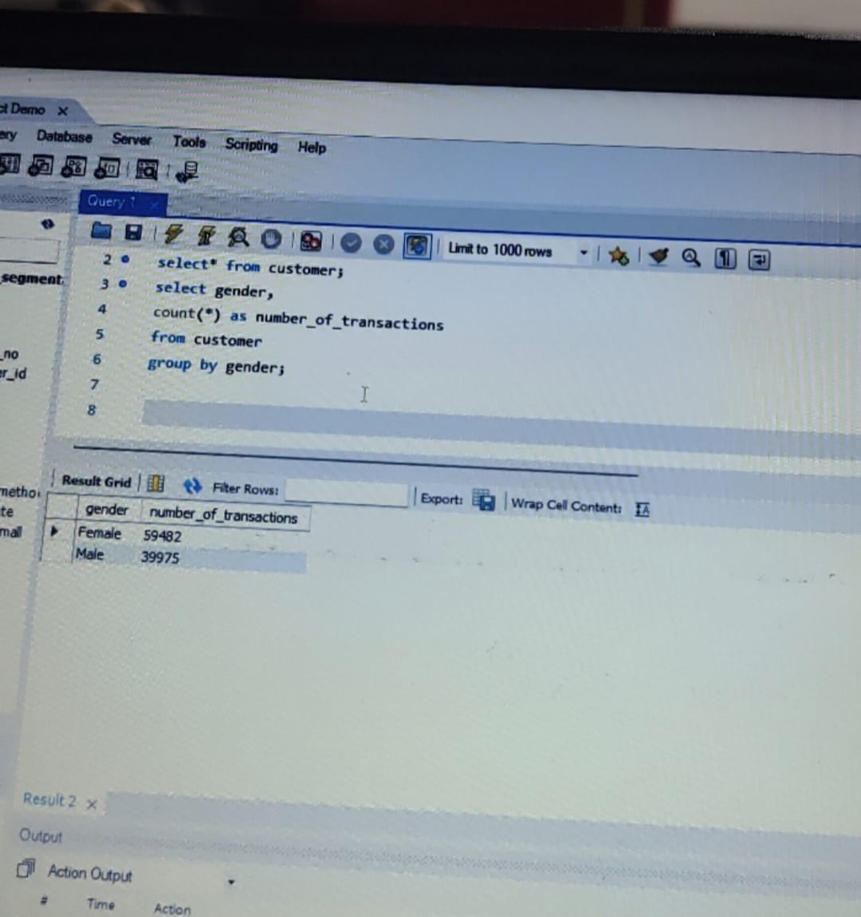
Most transactions by gender
The following queries represent the core logic used to solve Tasks 1–10.

Slide 16
Strategic Recommendations
Inventory Optimization: Expand floor space for Clothing and Technology
in the Mall of Istanbul, while evaluating the feasibility of low-performing categories in smaller malls.
Payment Incentives: Introduce "Debit-only" promotional days or small discounts to reduce the company's reliance on Credit Card processing fees.
Growth Strategy : "Develop a 'Premium Loyalty Tier' specifically for the 46+ demographic in top-tier malls like the Mall of Istanbul and Kanyon, as they show higher-than-average spending resilience in this segment
Analyst Note: Source: Cleaned SQL Transactional Database (99k+ rows)

Slide 17
Minor Insights
While we lead with youth, our most stable and growing 'hidden' segment is the 46+ group using the most cash at the Mall of Istanbul. Regardless of how we filter the data—by age, gender, or payment method—the Mall of Istanbul consistently captures 24% of our revenue. This proves it is our most stable and reliable operational model.
Because the product hierarchy (Clothing > Shoes > Technology) remains identical across different data slices, we should prioritize 'Cross-Category' promotions—like offering a discount on Shoes when a customer buys high-end Clothing.
Analyst Note: Source: Cleaned SQL Transactional Database (99k+ rows)

